Slide 1
Recap lecture 20
Recap Theorem, Example, Finite Automaton with output, Moore machine, Examples

Slide 2
Example
To identify the relation between the input strings and the corresponding output strings in the following Moore machine,
a
a
b
b
q₂/0
a
q₀/0
q₁/0
q₃/1
a
b
b

Slide 3
Example continued …
if the string bbbabaabbaa is run, the output string will be 000010000010, as shown below
Input
b
b
b
a
b
a
a
b
b
a
a
State
q₀
q₁
q₂
q₂
q₃
q₁
q₀
q₀
q₁
q₂
q₃
q₀
output
0
0
0
0
1
0
0
0
0
0
1
0

Slide 4
Example continued …
It can be observed from the given Moore machine that q₃ is the only state which prints out the character 1 which shows that the moment the state q₃ is entered, the machine will print out 1. To enter the state q₃, starting from q₀ the string must contain bba. It can also be observed that to enter the state q₃ once more the string must contain another substirng bba. In general the input string will visit the state q₃ as many times as the number of substring bba occurs in the input string. Thus the number of 1’s in an output string will be same as the number of substring bba occurs in the corresponding input string.

Slide 5
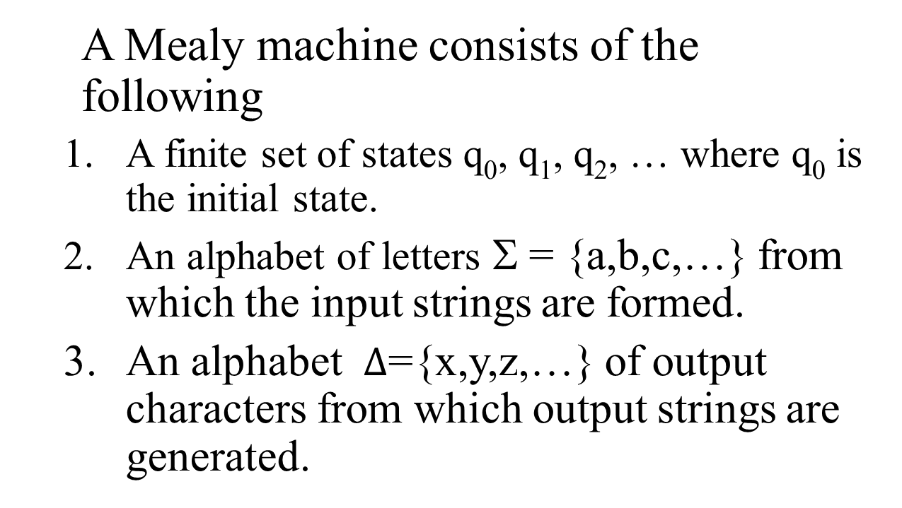
Mealy machine

Slide 6
Mealy machine continued …
4. A pictorial representation with states and directed edges labeled by an input letter along with an output character. The directed edges also show how to go from one state to another corresponding to every possible input letter.
Note: It is not possible to give transition table in this case.

Slide 7
Mealy machine continued …
Note: It is to be noted that since, similar to Moore machine, in Mealy machine no state is designated to be a final state, so there is no question of accepting any language by Mealy machine. However in some cases the relation between an input string and the corresponding output string may be identified by the Mealy machine. Moreover, the state to be initial is not important as if the machine is used several times and is restarted after some time, the machine will be started from the state where it was left off. Following are the examples

Slide 8
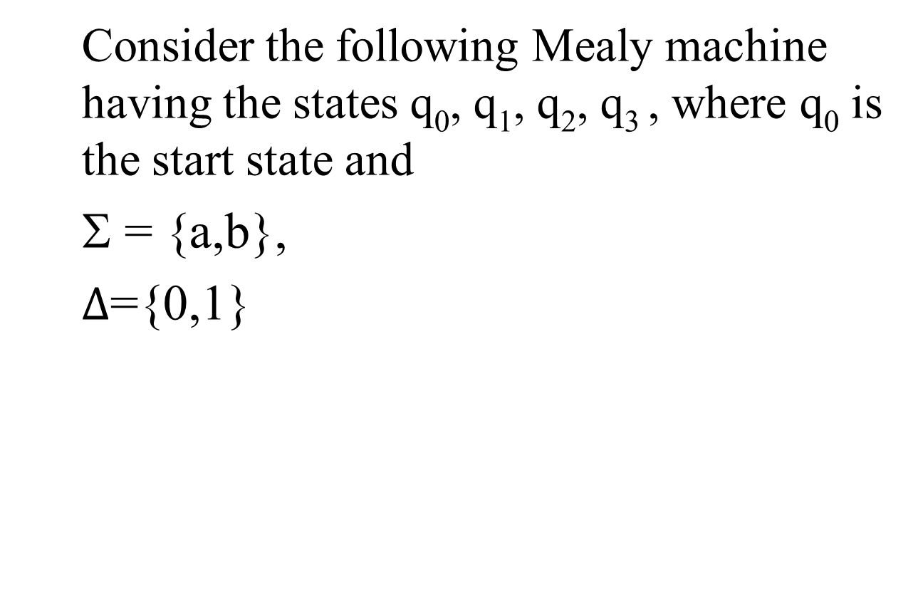
Example
q₁
b/1
q₂
a/0
a/0
a/1
b/1
q₀
b/0
q₃
a/1
b/1

Slide 9
Example continued …
q₁
b/1
q₂
Running the string abbabbba over the above machine, the corresponding output string will be 11011010, which can be determined by the following table as well
a/0
a/0
a/1
b/1
b/0
q₀
q₃
a/1
b/1

Slide 10
Example continued …
It may be noted that in Mealy machine, the length of output string is equal to that of input string.
Input
a
b
b
a
b
b
b
a
States
q₀
q₁
q₂
q₃
q₃
q₀
q₃
q₀
q₁
output
0
1
1
1
1
0
1
0

Slide 11
Example
Consider the following Mealy machine having the states q₀, q₁, q₂ , where q₀ is the start state and
Σ = {a,b},
={0,1}
b/0
a/1
q₁
q₂
b/1
a/0
a/0
b/0
q₀

Slide 12
Example continued …
It is observed that in the above Mealy machine, if in the output string the nth character is 1, it shows that the nth letter in the input string is the second in the pair of double letter.
For babaababba as input string the machine will print 0000100010.

Slide 13
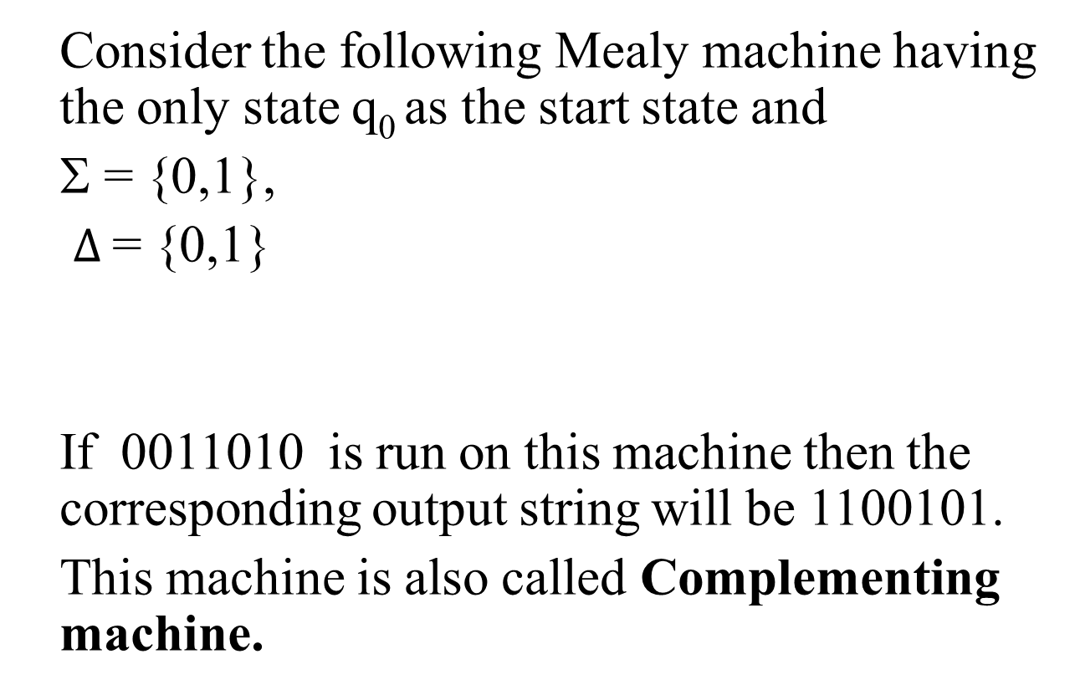
Example
0/1, 1/0
q₀

Slide 14
Constructing the incrementing machine
In the previous example of complementing machine, it has been observed that the input string and the corresponding output string are 1’s complement of each other. There is a question whether the Mealy machine can be constructed, so that the output string is increased, in magnitude, by 1 than the corresponding input string ? The answer is yes.
This machine is called the incrementing machine. Following is how to construct the incrementing machine

Slide 15
Constructing the incrementing machine continued …
Before the incrementing machine is constructed, consider how 1 is added to a binary number.
Since, if two numbers are added, the addition is performed from right to left, so while increasing the binary number by 1, the string (binary number) must be read by the corresponding Mealy machine from right to left, and hence the output string (binary number) will also be generated from right to left.

Slide 16
Constructing the incrementing machine continued …
  Consider the following additions
  a) 100101110 b) 1001100111
  + 1 + 1
  100101111 1001101000
  It may be observed from the above that
  a) If the right most bit of binary number, to be incremented, is 0, the output binary number can be obtained by converting the right most bit to 1 and remaining bits unchanged.

Slide 17
Constructing the incrementing machine continued …
b) If the right most bit of binary number is 1 then the output can be obtained, converting that 1 along with all its concatenated 1’s to 0’s, then converting the next 0 to 1 and remaining bits unchanged.
The observations (a) and (b) help to construct the following Incrementing (Mealy) machine.

Slide 18
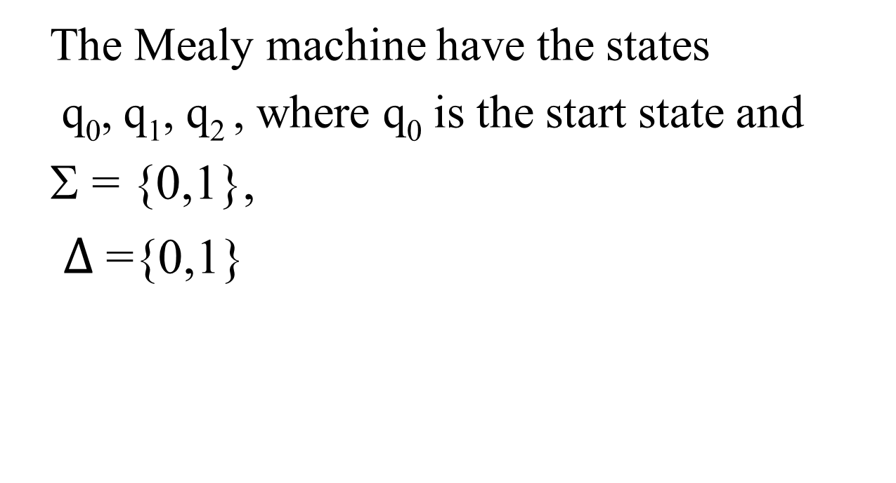
Constructing the incrementing machine continued …
0/0, 1/1
q₁
0/1
q₂
1/0
0/1
1/0
q₀

Slide 19
Constructing the incrementing machine continued …
It may be observed that, in the incrementing machine, if 0 is read at initial state q₀, that 0 is converted to 1 and a no change state q₁ (no carry state) is entered where all 0’s and all 1’s remain unchanged. If 1 is read at initial state, that 1 is converted to 0 and the state q₂(owe carry state) is entered, where all 1’s are converted to 0’s and at that state if 0 is read that 0 is converted to 1 and the machine goes to no change state.
If the strings 100101110 and 1001100111 are run over this machine, the corresponding output strings will be 100101111 and 1001101000 respectively.

Slide 20
Note
It is to be noted that if the string 111111 is run over the incrementing machine, the machine will print out 000000, which is not increased in magnitude by 1. Such a situation is called an overflow situation, as the length of output string will be same as that of input string.
It may also be noted that there exists another incrementing machine with two states.

Slide 21
Summing Up
Example of Moore machine, Mealy machine, Examples, complementing machine, Incrementing machine.

Slide 22
Slide 24
is to be corrected during insertion (a reminder for Saad as well as editing team).
Line is If 1 is read at initial state, that 1 is converted to 0 and the state q₂(owe carry state) is entered,
Sir’s line is incorrect

